Slide 1
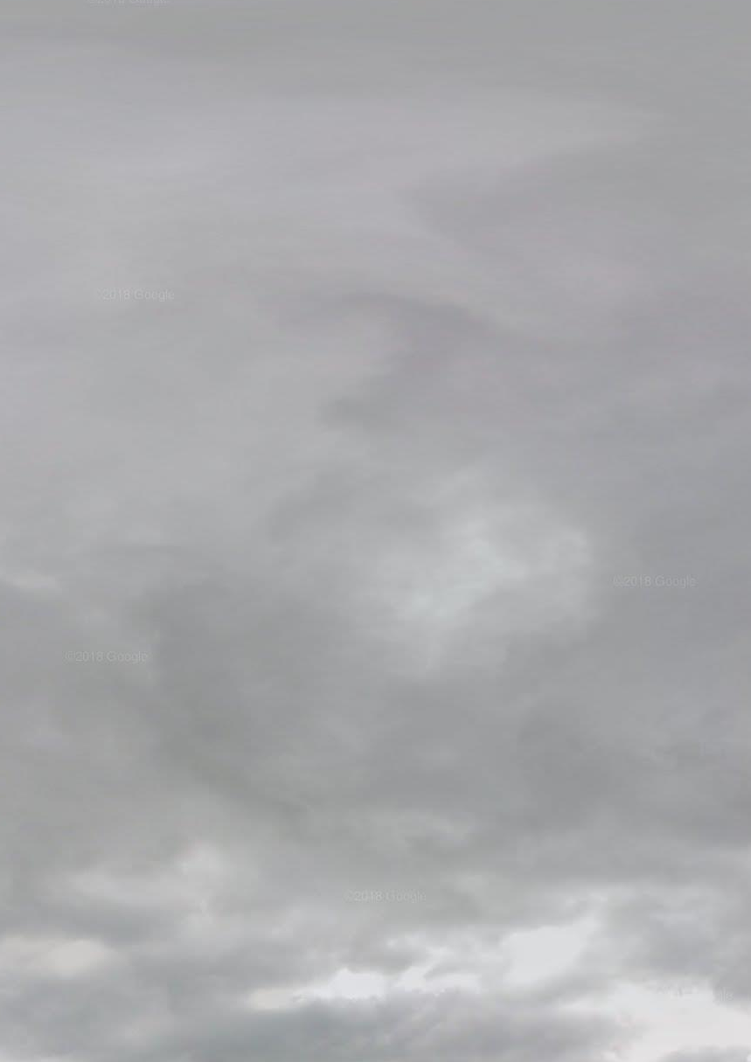
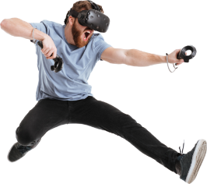
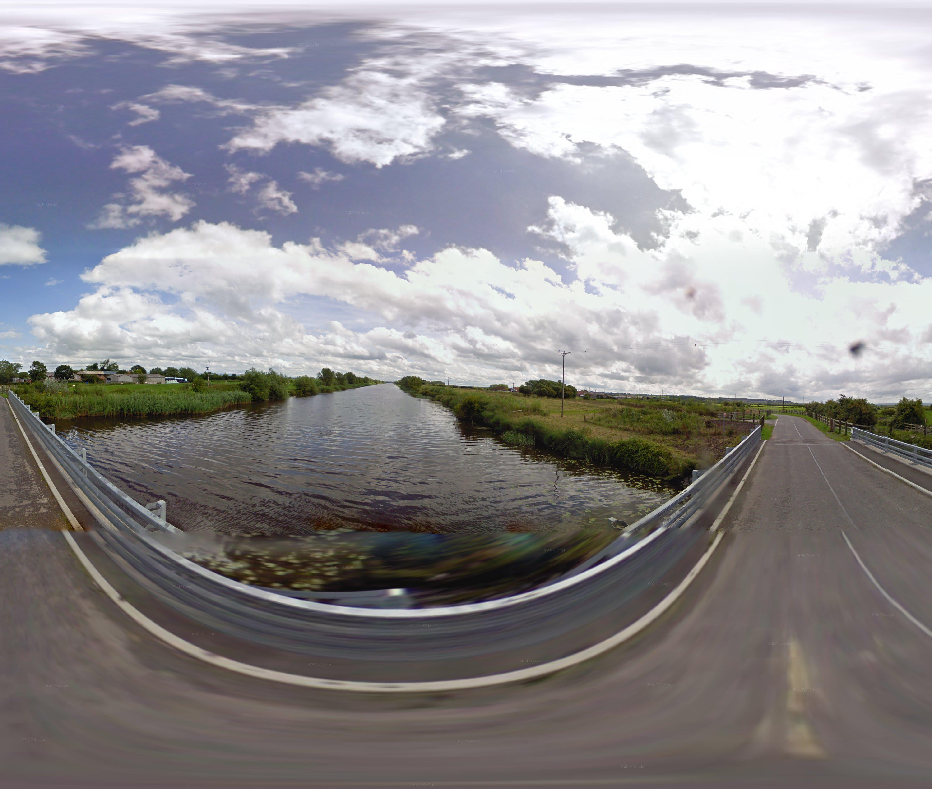

A toolkit to produce inexpensive and realistic skyboxes for games
Utilising machine learning, this project intends to produce realistic skyboxes for games. Static realistic skies provide a multitude of benefits for games, particularly in the VR space, where rendering optimisation is key.
The project up to this point has focussed on building a toolkit to source images that can train the machine learning algorithm to produce the realistic skies. On show is that toolkit, which utilises Google Streetview to pull HDR sky data.
Matt Filer
UFCFS4-30-3 2019/20
Creative Technologies Project

